Slide 1

COMP2001 Database Connections
Martin Read

Slide 2
Session
Describe functionality and features of various database connectivity technologies

Slide 3
Single Page Application
User navigates to web address
Server responds with HTML and multiple JS files containing client-side code
Browser gets files, displays to user. User interacts (e.g. clicks button)
JS code handles click, calls server side for data
Server receives request for data, retrieves & sends it back
JS handles response & generates HTML
In traditional web applications user navigates between different pages retrieved separately from server on request
SPA only has one page
Contains whole application
All UI changes made using JavaScript
Welcome modern frameworks of Angular, React, Viee etc..

Slide 4
Database Connectivity
Azure Data Studio
So far – used tools to view the database
SQL is the language used to extract or manipulate data
Data residing in the data layer
In the middle layer we see data logic, data transformations & ”how” to talk to the database
Connectivity often referred to as “middleware”
Presentation
Business
Data

Slide 5
Connectivity options (not exhaustive)
Native SQL Connectivity – provided by vendor
ODBC, DAO and RDO
Open Database Connectivity
Data Access Objects
Remote Data Objects
OLE-DB – Object Linking and Embedding for Database
ADO.NET
PDO – PHP Data Objects
Notes:
ODBC was first major access standard – older programmes will use it – maybe if you have to come across any legacy systems you would need to understand it. It required that you first installed the ODBC for the specific database on your machine (and/or on the deployed machine). Then you had a way of getting to the data.
DAO – objects that will help provided access. Third party or self-written.
RAO – uses DAO and ODBC but is optimized for the databases that are deployed remotely.
OLE-DB provided a series of COM objects to give a low-level connectivity. It allowed access to non-relational databases.
ADO.NET is part of the Microsoft .NET offering. It replaced the earlier options for connectivity.

Slide 6
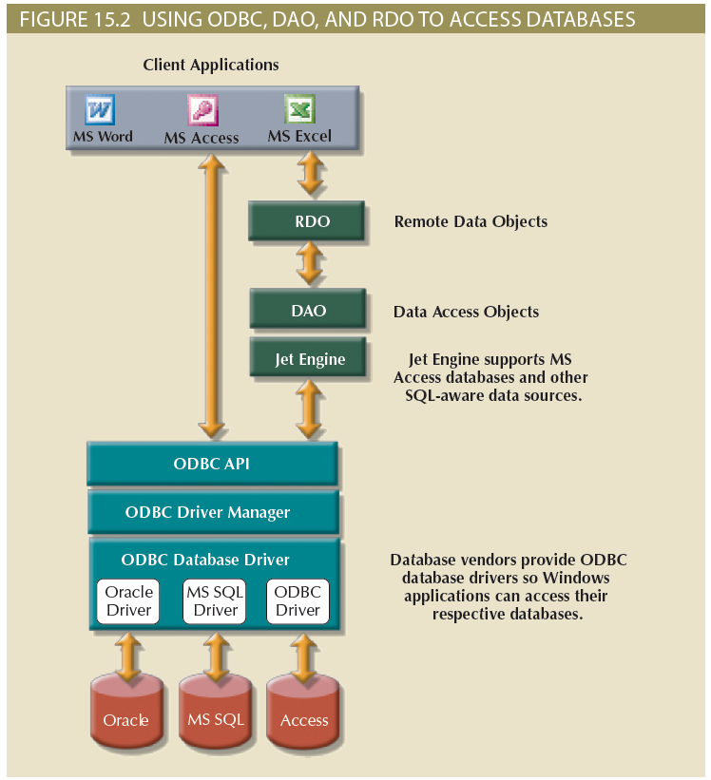
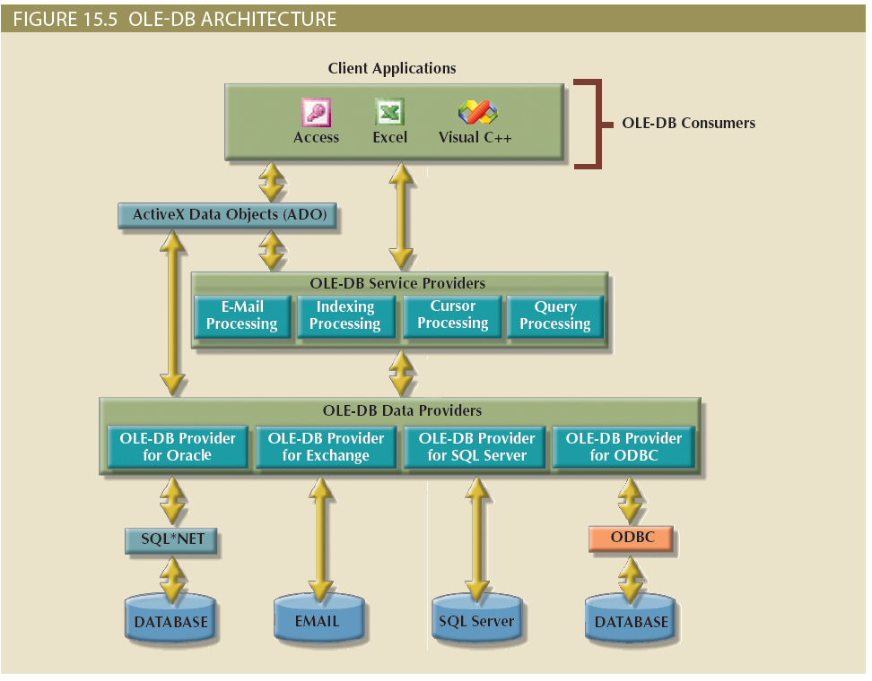

Slide 7
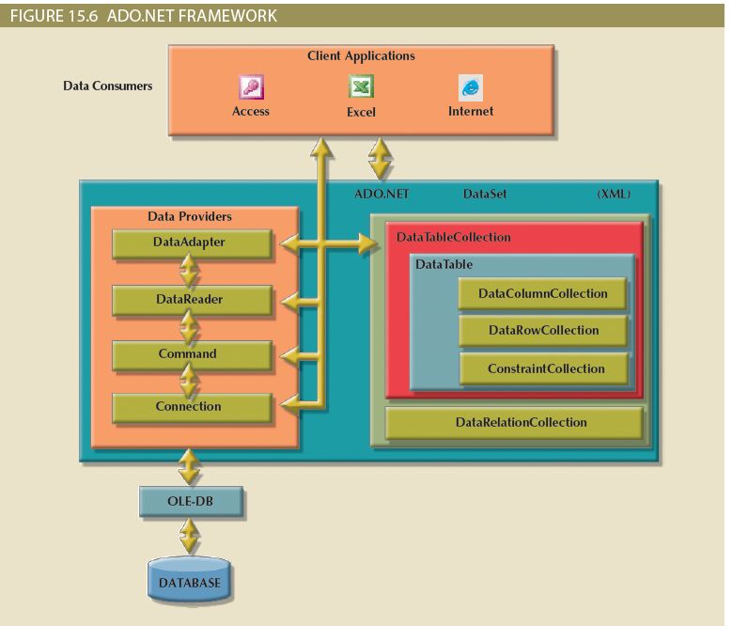

Slide 8
Active Server Pages (ASP)
Microsoft's first server-side scripting technology for creating dynamic interactive web pages
Initial release as add-on to IIS
Uses scripting on the Server to generate content
sent to the client's web browser via HTTP response
ASP interpreter reads & executes all script code
Web pages with the .asp filename extension use ASP - also .htm or .html extensions

Slide 9
What is ASP?
text file script
contains HTML, client- & server-side script
Scripts written in plain text , created using any text editor
Runs from server-side - not within a browser
Server process scripts when called from a web client
Processed by Web server before sending to browser

Slide 10
ASP.NET
Active Server Pages Network Enabled Technologies
Open-source, server-side web-application framework
Developed by Microsoft to allow programmers to build dynamic web sites, applications & services
ASP.NET has strong eco-system designed to make things easier
Supports a number of programming models for building web applications – including MVC
3 frameworks: Web Forms, ASP.NET MVC & ASP.NET Web Pages – all now merged into ASP.NET Core
Saved as .aspx (also .cshtml & .vbhtml)

Slide 11
What is ASP.net?
Client sends request to web Server
Web Server uses ASP Interpreter to process code in ASP script
Interpreter opens connection to database & sends the SQL commands embedded in the ASP script
Interpreter processes information returned by database into HTML file - sent back to web Server
Web Server returns a HTML page to the Client
Note: this file never exists in the Server file system - a dynamic page generated on-the-fly

Slide 12
How does ASP work?
ASP Scripts
ASP
WWW
Connection
DB
ADO
Internet
HTML
Internet Information Server

Slide 13
Database Connections
Design decisions to be made
Use of middleware
API
Direct link
Context dependent
Some data can be shared via API (more on that later)
Some functions that use data need to run on the DB (stored procedures) & results shared via API
Some applications need a direct link

Slide 14
Database Connections
Web/Database model
commonly used to share data between database & programs
Connection is made to a specific database in a specific location. Each database has its’ own connection
Connection handles interaction with database (opening & managing data exchanges) & processing of SQL commands

Slide 15
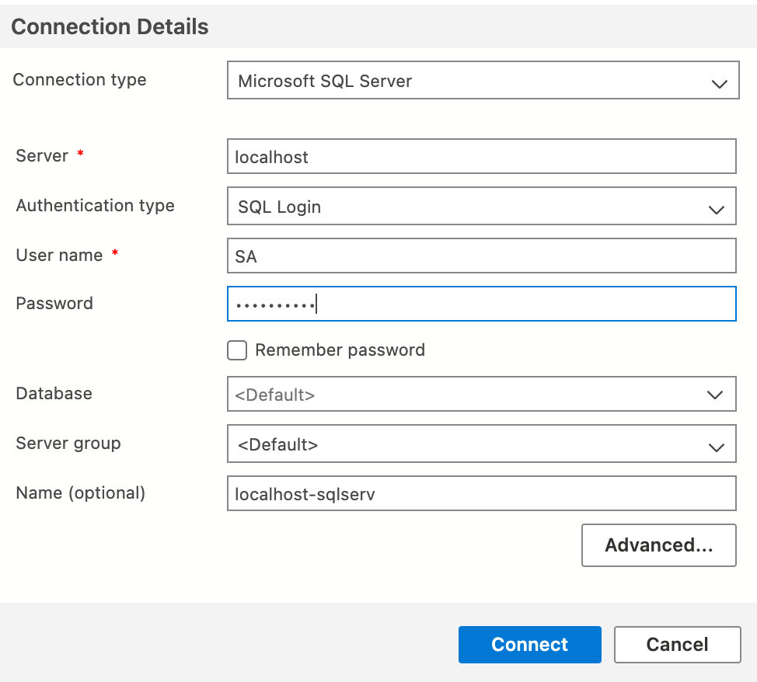
Azure Data Studio

Slide 16
Simple ASP.NET MVC Example
Using Visual Studio to examine standard MVC application
Connection String specifies location & name for database
Plus configuration settings
Need to ensure you have the ADO.NET connection strings for a .NET application
Connection strings should be one unbroken line
Stored in JSON file called appsettings.json
LocalDb – free local installation of SQL Server that comes with VS
Means you can code locally
BUT you need to set up for remote working later
Stack in use = Microsoft SQL Server, IIS, ASP.NET Core

Slide 17
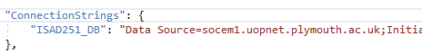
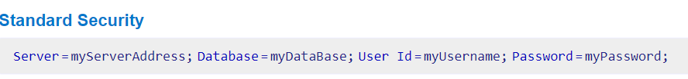
appsettings.json

Slide 18
ASP.NET and C#
Creating a traditional web application to begin with
Single Page Applications (SPA’s) used when you need a rich interface with many features
SPA’s will rely heavily on the JavaScript frameworks
Create an MVC application based on the database you already have
Code First workflow
Storing password details in appsettings.json is not that secure for deployment & you might use the built in Secret Manager*
*But NOT expected for this module
Notes:
Secret Manager - https://docs.microsoft.com/en-us/aspnet/core/security/app-secrets?view=aspnetcore-3.0&tabs=windows#secret-manager
Connection strings for any type of DB can be found here https://www.connectionstrings.com/

Slide 19
ASP.NET : Application
Use NuGet to install Entity Framework. Use the Package Manger Console
Install-Package Microsoft.EntityFrameworkCore
POCO – Plain Old Class Object
Must map to the data types for the columns
Use getter and setter
Create a DbContext class
Inherits from the DbContext base class
Add in DbSet to represent the values from the tables
Uses the repository combined with unit of work patterns
Note pluralisations of the DbSets

Slide 20

University of Plymouth
Advancing knowledge, transforming lives

